Slide 1
Certificate Cothority: Towards Trustworthy Collective CAs
Ewa Syta, Iulia Tamas, Dylan Visher, David Wolinsky, Bryan Ford
Yale University HotPETs 2015

Slide 2


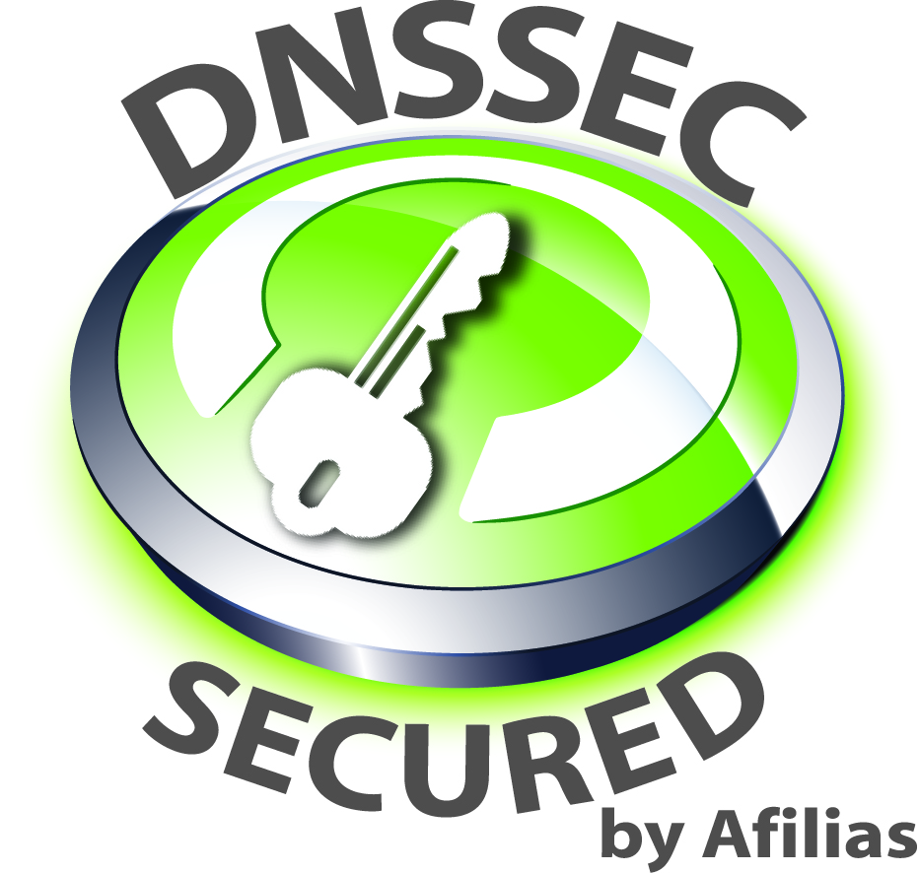

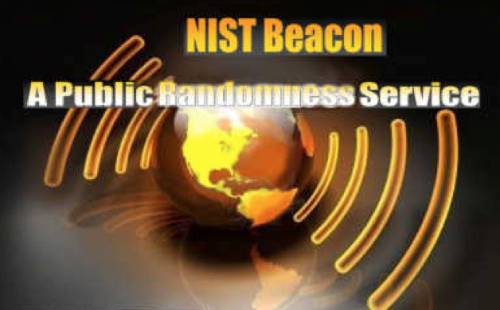




“Authorities” are Everywhere
Conceptually simple but security-critical services
  Logging and Time-stamping Authorities
  Naming Authorities
  Randomness Authorities (e.g., lotteries)
  Digital Notaries
  Certificate Authorities (CAs)

Slide 3
Talk Outline
Troubles with Certificate Authorities
Designing Certificate Cothorities
  Scalable Collective Schnorr Log-Signing
  The Availability Problem
Prototype and Preliminary Results
Deployment Scenarios
Conclusions

Slide 4
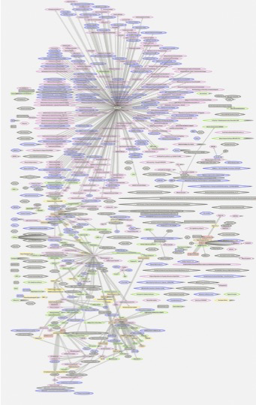
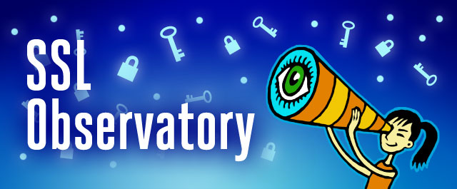
Certificate Authorities
EFF SSL Observatory
~650 CAs trusted by Mozilla or Microsoft
Any CA can issue certs for any domain
Prime key target
  MITM attack power
Breaches do happen
  DigiNotar’11
  Comodo’11
  CNNIC/MCS’15

Slide 5

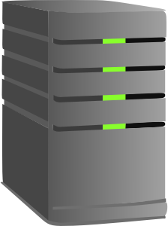






Certificate Authorities
google.com
Fake Google.com
_{(MITM Attacker)}
Certificate Authorities
Pwned!
Client

Slide 6
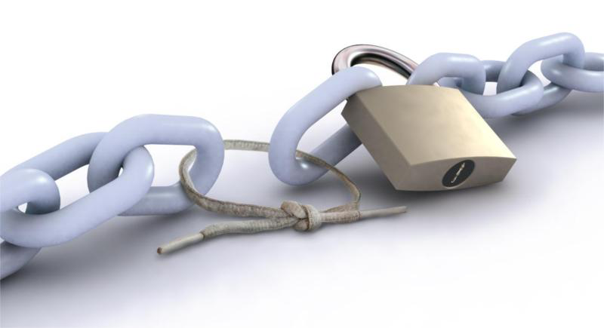
If we trust many CAs…
Attacker gets to choose which one to attack
→ Weakest-link security overall

Slide 7
Current Defenses
Oversight from industry organizations, browser and OS vendors
Pinning: embed certificates/CAs into the browser
Logging and monitoring
  Certificate Transparency (CT) [Laurie’11]
  Convergence [Marlinspike’11]
  AKI [Kim’13]
  ARPKI [Basin’14]
  PoliCert [Szalachowski’14]

Slide 8



Certificate Transparency
google.com
CAs
Fake Google.com
_{(MITM Attacker)}
Real
Log servers
!!!
Client
Monitors/Auditors

Slide 9








CT’s Weakness: Privacy
google.com
CAs
Fake Google.com
_{(MITM Attacker)}
Log servers
Client
Monitors/Auditors

Slide 10
CT’s Weakness: Retroactive Security
google.com
CAs
Fake Google.com
_{(MITM Attacker)}
Cert timestamp
(signed)
Cert logged
Time
Bad cert detected
Log servers
Pwned!
Client
Cert revoked
Monitors/Auditors

Slide 11

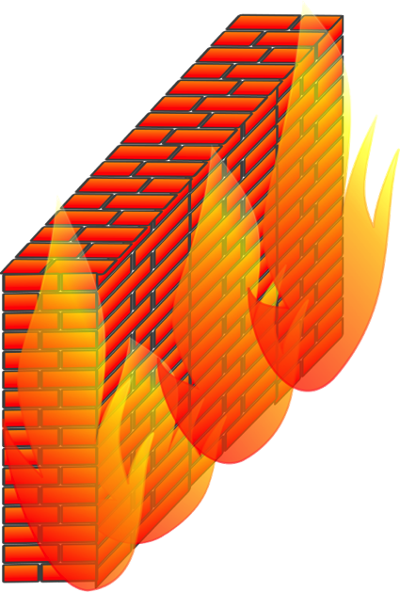
CT’s Weakness: Blocking
google.com
CAs
Fake Google.com
_{(MITM Attacker)}
Dave the Dictator
Log servers
X
Pwned!
Client
Monitors/Auditors

Slide 12
We need “Collective Authorities”
X
google.com
CAs
X
Fake Google.com
_{(MITM Attacker)}
Need: collective validation, sign-off
Collective Authority = Cothority
Log servers
Client
Monitors/Auditors

Slide 13
Talk Outline
Troubles with Certificate Authorities
Designing Certificate Cothorities
  Scalable Collective Schnorr Log-Signing
  The Availability Problem
Prototype and Preliminary Results
Deployment Scenarios
Conclusions

Slide 14
Certificate Cothority (CC)
Many parties collectively sign, not just a single CA
  All participating CAs can propose new certs, all verify
  Hundreds or thousands of diverse participants
    CAs, log servers, monitors, auditors
    Easy to include new participants
Collective signature = many servers sign off
  Any CA can block signature if cert violates policy
  Simple verification as if there is one CA
  Secure unless many servers compromised

Slide 15
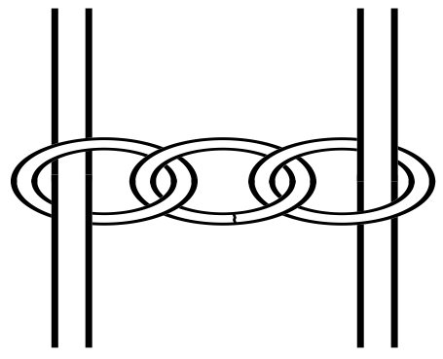
Why Certificate Cothority?
From this
model…

Slide 16
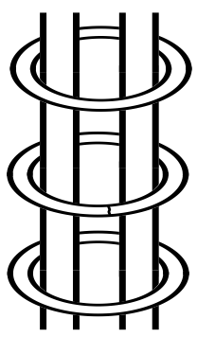
Why Certificate Cothority?
To this model

Slide 17
Talk Outline
Troubles with Certificate Authorities
Designing Certificate Cothorities
  Scalable Collective Schnorr Log-Signing
  The Availability Problem
Prototype and Preliminary Results
Deployment Scenarios
Conclusions

Slide 18
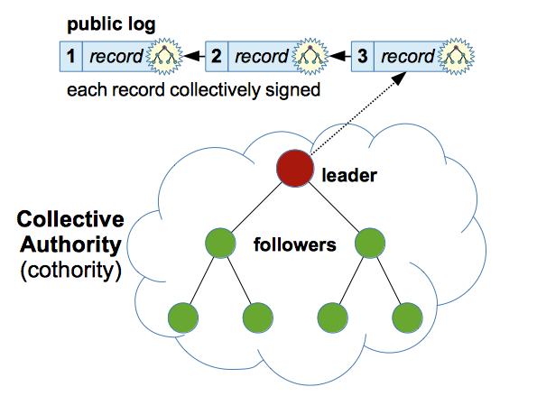
CoSi: Collective Signing

Slide 19
CoSi: Scalable Collective Signing
CoSi builds upon existing primitives
  Merkle Trees [Merkle’79]
  Schnorr Signatures [Schnorr’89] and Multisignatures [Itakura’83],[Ohta’99],[Micali’01],[Bellare’06]
Our contribution
  Scale multisignatures to thousands of nodes
  Communication trees and aggregation, as in scalable multicast protocols

Slide 20
Merkle Trees
  Every non-leaf node labeled with the hash of the labels of its children.
Efficient verification of items added into the tree
top hash
G=H(H(E)|H(F))
?
E=H(H(A)|H(B))
F=H(H(C)|H(D))
H(A)
H(B)
H(C)
H(D)
A
B
C
D

Slide 21
Schnorr Signature
Generator g of prime order q group
Public/private key pair: (K=g^{k}, k)
Signer
Verifier
Commitment
V=g^{v}
V
Challenge
c
c = H(M|V)
Response
r = (v – kc)
r
Signature on M: (c, r)
Commitment recovery
V' = g^{r}K^{c}
= g^{v-kc}g^{kc} = g^{v} = V
Challenge recovery
c’ = H(M|V’)
Decision
c’ = c ?

Slide 22
Collective Signing
Our goal is collective signing with N signers
  Everyone produces a signature
  N signers-> N signatures -> N verifications!
  Bad for hundreds or thousands of signers!
Better choice – a multisignature

Slide 23

Schnorr Multisignature
Key pairs: (K₁=g^{k1}, k₁) and (K₂=g^{k2}, k₂)
Signer 1
Signer 2
Verifier
Commitment
V₁=g^{v1}
V₂=g^{v2}
V₁
V₂
V=V₁*V₂
Challenge
c
c
c = H(M|V₁)
c = H(M|V)
Response
r₁ = (v₁ – k₁c)
r₂ = (v₂ – k₂c)
r₁
r₂
r=r₁+r₂
Collective Signature on M: (c, r)
Same signature!
Commitment recovery
Same verification!
V' = g^{r}K^{c}
K=K₁*K₂
Challenge recovery
Done once!
c’ = H(M|V’)
Decision
c’ = c ?

Slide 24
CoSi Protocol
Announcement Phase
Commitment Phase
Challenge Phase
Response Phase
M
V₁ = V₁V₂…V_{N}
(aggregate)
V₃ = g^{v3}
(individual)
c= H(M|root)
r₁ = r₁+r₂+…+r_{N}
(aggregate)
r₃ = v₃ – k₃c
(individual)
Collective signature (c, r₁)

Slide 25
Talk Outline
Troubles with Certificate Authorities (CAs)
Designing Certificate Cothorities
  Scalable Collective Schnorr Log-Signing
  The Availability Problem
Prototype and Preliminary Results
Deployment Scenarios
Conclusions

Slide 26
Exceptions
If node A fails, the remaining nodes can still provide a valid signature but
  For a modified collective key: K’= K * K⁻¹_{A}
Client gets a signature under K’ and an exception e_{A}
  e_{A} also lists conditions under which it was issued
Client accepts only if a quorum of nodes maintained

Slide 27
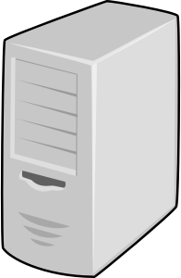


Life Insurance Policy
Node "insures" its private key by depositing the key shares with other servers (insurers)
If node fails, others recover the key and continue
Use verifiable secret sharing
s₁
s₂
s₃

Slide 28
Talk Outline
Troubles with Certificate Authorities
Designing Certificate Cothorities
  Scalable Collective Schnorr Log-Signing
  The Availability Problem
Prototype and Preliminary Results
Deployment Scenarios
Conclusions

Slide 29
Implementation
Implemented in Go with DeDis crypto library
  https://github.com/DeDiS/prifi/tree/master/coco
  https://github.com/DeDiS/crypto
Schnorr multisignatures on Ed25519 curve
  AGL's Go port of DJB's optimized code
Run experiments on DeterLab
  Up to 4096 virtual CoSi nodes
  Multiplexed atop up 32 physical machines
  Latency: 100ms roundtrip between two servers

Slide 30
Preliminary Results

Slide 31
Talk Outline
Troubles with Certificate Authorities
Designing Certificate Cothorities
  Scalable Collective Schnorr Log-Signing
  The Availability Problem
Prototype and Preliminary Results
Deployment Scenarios
Conclusions

Slide 32
Certificate Cothority
Go Daddy
Google
Leader
Apple
google.com
Comodo
Google.com
Mozilla
VeriSign
DigiCert
GlobalSign
Client

Slide 33
Deployment Scenarios
Most Ambitious
Ideal case: everyone in certificate cothority
  Everyone gets to check certs but difficult to deploy
Browser-driven certificate cothority
  Browser vendor acts as a CC leader and CAs gradually join (eventually must) to remain in the root store
Root-CA-centric certificate cothority
  Root-CA as a leader and intermediate CAs gradually join (eventually must) to retain their signing power
Log server-driven certificate cothority
  Backward compatible
  CT-style: endorse signed certificate timestamps (SCTs)
Most Deployable

Slide 34
Conclusions
We can and should build a better CA system
  There seem to be no technical reason not to!
  Proactively secure: no bad certs endorsed
  Privacy-friendly: users don’t gossip their browsing history
Build it using cothorities
  Strongest-link security
  Built upon well-understood cryptographic primitives
  Scale to thousands of participants with reasonable delays
But it will definitely take time and effort

Slide 35
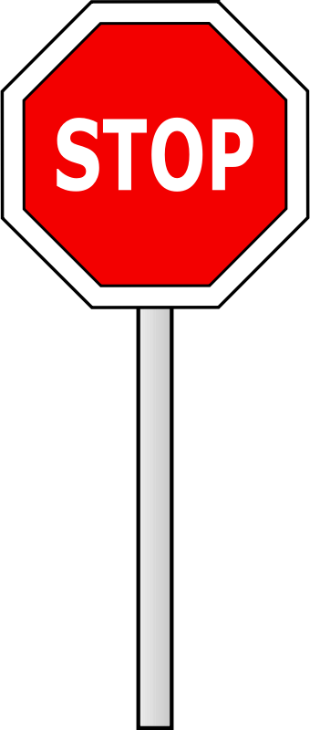
Thank you!
Let’s chat :)
More details
“Decentralizing Authorities into Scalable Strongest-Link Cothorities”
arXiv:1503.08768
ewa.syta@yale.edu

Slide 36
Additional Slides

Slide 37
(Potential) Cert Verification
“Suspicious” certs
  Issued by an usual CA
  Issued but previous not revoked
  Contains unusual settings (permissions, weak crypto, etc.)
Global CA Policy
  A known “division of power”
  Everyone checks compliance with the policy
Individual checks
    Each CA checks that no one else proposes a certificate they are responsible for

Slide 38
Leverage the CA System
No need to scrape the current CA system
  Building a new one is not that easy
  Need the existing infrastructure for EV/DV validation
Provide better tools and approaches to use it
Leverage what is good about it
  Administrative options to deal with availability and misbehavior
  Business relationships to “encourage” participation

Slide 39
CoSi: Protocol Setup
K₁, PK{k₁|K₁ = g^{k1}}
K₁ = K₁K₂…K_{N}
Merkle tree containing
  Public key K_{i} (discrete log)
  Self-signed certificates
  Aggregate keys K_{i}
O(n) one-time verify time
O(|n’-n|) group change
K₂, PK{k₂|K₂ = g^{k2}}
K₂ = K₂K₃K₄
K₃, PK{k₃|K₃ = g^{k3}}
K₃ = K₃
K₄, PK{k₄|K₄ = g^{k4}}
K₄ = K₄

Slide 40
CoSi: Commit Phase
V₁ = g^{v1}
V₁ = V₁V₂…V_{N}
Challenge c = H (…)
Merkle tree containing
  Commits V_{i}
  Aggregate commits V_{i}
Collective challenge c is root hash of per-round Merkle tree
V₂ = g^{v2}
V₃ = V₂V₃V₄
V₃ = g^{v3}
V₃ = V₃
V₄ = g^{v4}
V₄ = V₄

Slide 41
CoSi: Response Phase
r₁ = v₁ – k₁c
r₁ = r₁+r₂+…+r_{N}
Compute
  Responses r_{i}
  Aggregate commits r_{i}
Each (c, r_{i}) forms valid partial signature
(c, r₁) forms complete signature
r₂ = v₂ – k₂c
r₂ = r₂+r₃+r₄
r₃ = v₃ – k₃c
r₃ = r₃
r₄ = v₄ – k₄c
r₄ = r₄

Slide 42
Splitting Trust in Authorities
We know how to:
Split trust across a few servers, typically <10
  “Anytrust”: only 1-of-k servers need be honest,but all k servers need to remain live
  Byzantine Fault Tolerance (BFT): 2/3 of k servers need to be honest, 2/3 need to be live
Split cryptographic keys, operations
  Threshold cryptography, multisignatures
Example: Tor directory authority (8 servers)

Slide 43
Small-Scale Trust-Splitting
Is splitting trust across 5-10 replicas “enough”?
Who owns/controls these replicas?
  Truly independent operators (decentralized),or within one organization (merely distributed)?
  All in same country? All in “five-eyes” territory?
What is the real cost of targeted attacks?
  5 Tor directory server private keys might bewell worth the cost of a 0-day exploit or two
Who chooses the 5-10 replicas?
  Why should “everyone” trust them?

Slide 44
Exceptions
If node A fails, the remaining nodes can provide a valid signature but
  For a modified collective key: K’= K * K⁻¹_{A}
  Using a modified commitment: V’= V * V⁻¹_{A}
  And response: r’= r – r_{A}
Client gets a signature under K’ and an exception e_{A}
  e_{A} also lists conditions under which it was issued
Client accepts only if a quorum of nodes maintained

Slide 45
The Availability Problem
Assume server failures are rare but non-negligible
  Availability loss, DoS vulnerability if not addressed
  But persistently bad servers administratively booted
Two approaches:
  Exceptions – currently implemented, working
  Life Insurance – partially implemented, in-progress

Slide 46
Preliminary Results

Slide 47
Preliminary Results

