Slide 1
Hiding in a Panopticon:
Grand Challenges in Internet Anonymity
Bryan Ford, David Isaac Wolinsky, Joan Feigenbaum,
Henry Corrigan-Gibbs, Ewa Syta, John Maheswaran, Ramakrishna Gummadi – Yale
Vitaly Shmatikov, Amir Houmansadr,
Chad Brubaker – UT Austin
Aaron Johnson – US Naval Research Lab
NDSS/SENT Workshop – February 23, 2014

Slide 2

“Nobody knows
you're a dog?”
Notes:
We used to say that on the Internet nobody knows you're a dog.
But times have changed.

Slide 3
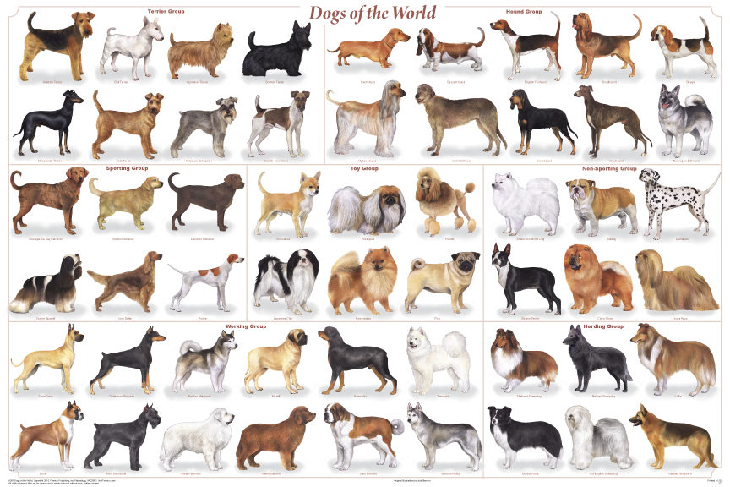
Actually, they know
exactly what kind you are
Notes:
On today's Internet everyone seems to know precisely what kind of dog you are

Slide 4
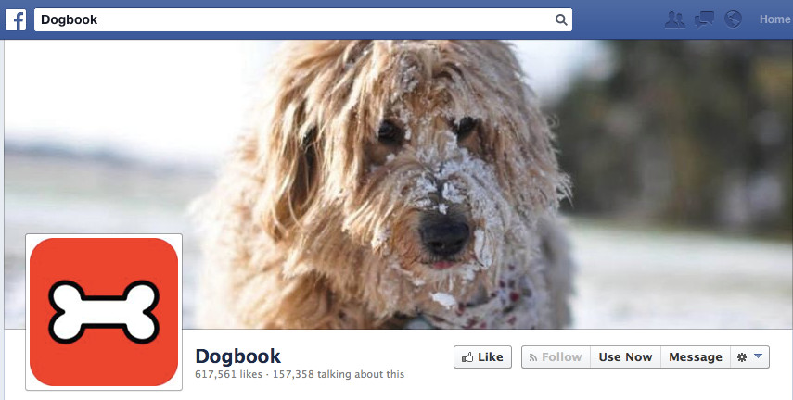
Who your friends are...
Notes:
Who your friends are

Slide 5

What
you're
doing
Notes:
What you do together

Slide 6

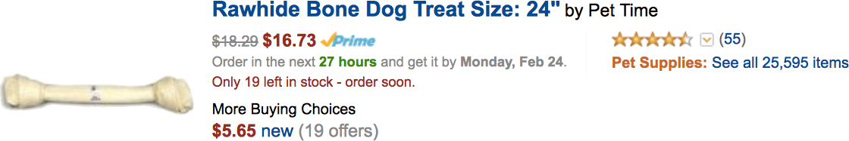
What you
and your friends
like to buy
dog
Gift suggestion ...
… based on Rover's Dogbook likes
Notes:
What kind of food and other products you and they like

Slide 7
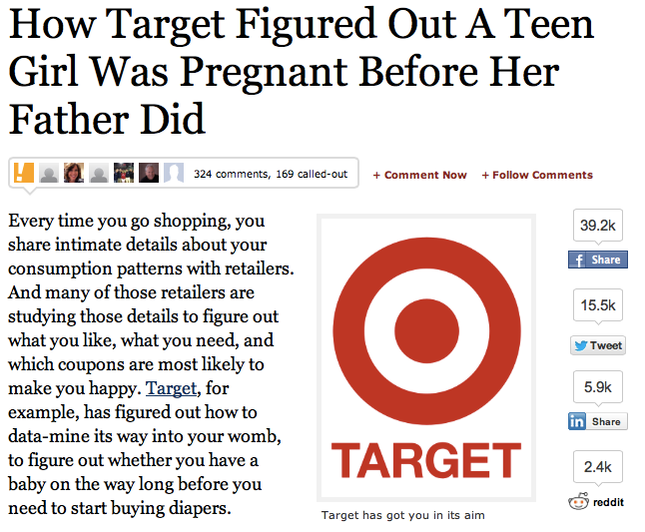

Dog
Notes:
They can even figure out when you're expecting a new family member before the rest of your family knows.

Slide 8
Why should I care about privacy
if I have nothing to hide?

Slide 9

Reason 1: Freedom of Thought
We invented computers to help us think.

Slide 10
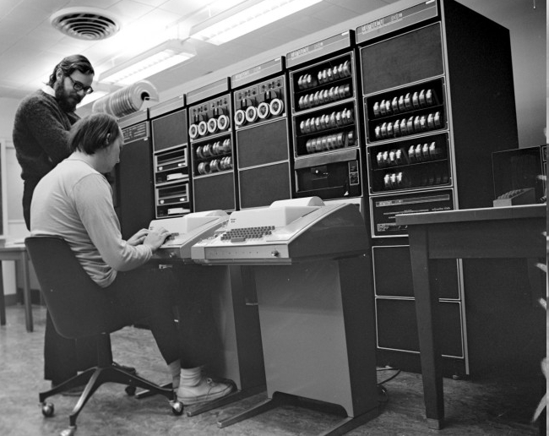

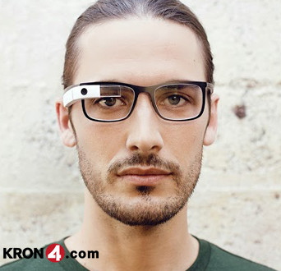

Reason 1: Freedom of Thought
We invented computers to help us think.
Ubiquity brings dependence

Slide 11
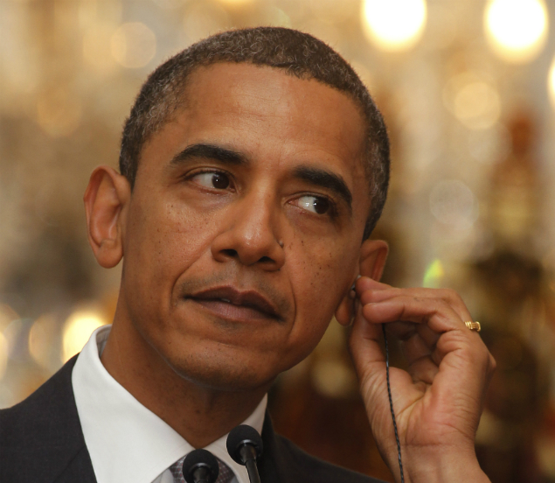

Reason 1: Freedom of Thought
We invented computers to help us think.
Ubiquity brings dependence
Whoever can read your private data
can read your thoughts

Slide 12
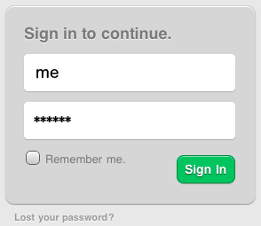
Reason 2: Personal Security
You think this is your password?

Slide 13
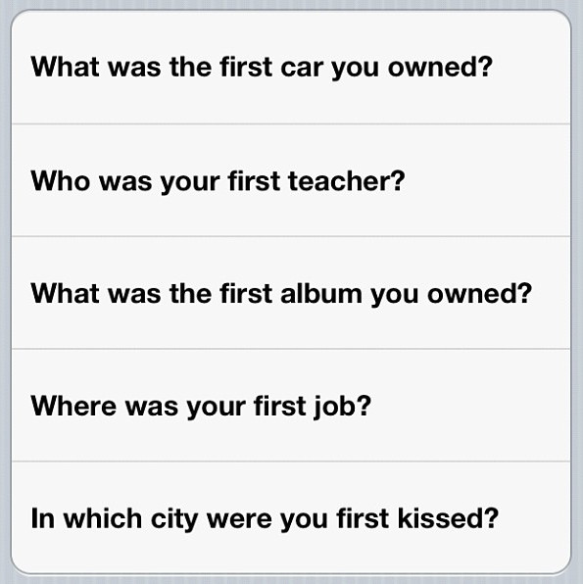
Reason 2: Personal Security
No, that's just a temporary access token.
This is your password.
Your life is
your password.

Slide 14
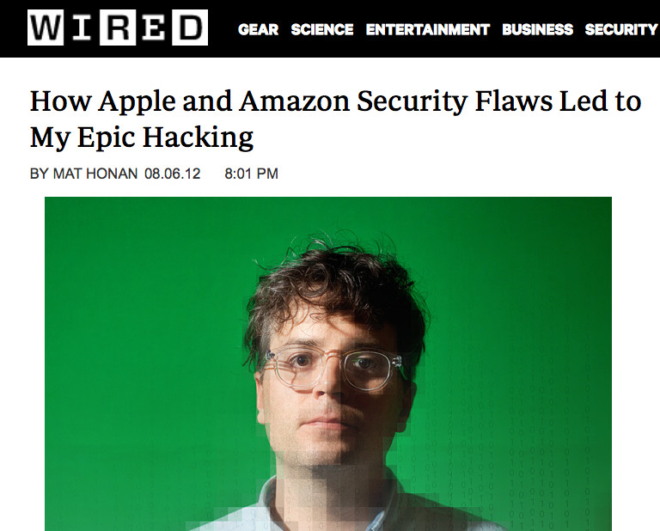
Reason 2: Personal Security
Whoever can
data-mine your life
has your password

Slide 15
Who Wants to Track You Online?
Advertisers (if you ever spend money)
Vendors (if you ever buy things)
Thieves (if you have any money)
Stalkers (if you're a domestic abuse victim)
Competitors (if you're a business)
Extremists (if you're minority/gay/pro-choice...)
The Police (if you're “of interest” w/in 3 hops)
The Mob (if you're the police)

Slide 16
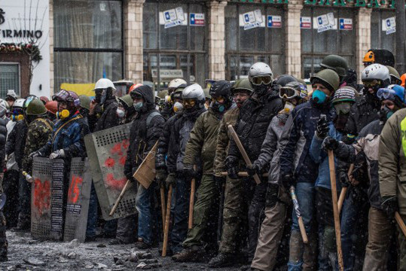

What tracking protection do we need?
Some people really need anonymity...

Slide 17
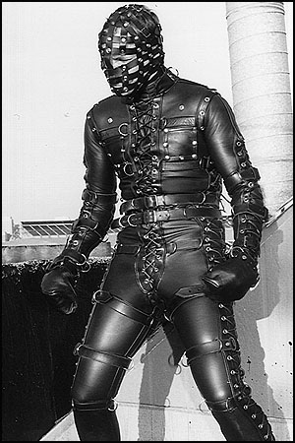


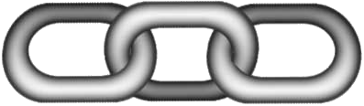



What tracking protection do we need?
Many people just tend to wear multiple hats
Hobby Hat
Family Hat
Professional Hat
Party Hat
The Real You

Slide 18
Talk Outline
Why Anonymity?
Current State of the Art
Grand Challenges in Anonymity
  Global traffic analysis
  Active interference attacks
  Intersection attacks
  De-anonymizing exploits
  Accountability provisions
Conclusion

Slide 19
What protection can we get now?
Many weak defense options
  Disable cookies, browser history, Flash, Java
  “Do-Not-Track” HTTP option
  “Hide” behind NATs, firewalls, corporate VPNs
  Commercial proxy/VPN providers
Current state-of-the-art
  Onion routing systems – e.g., Tor

Slide 20

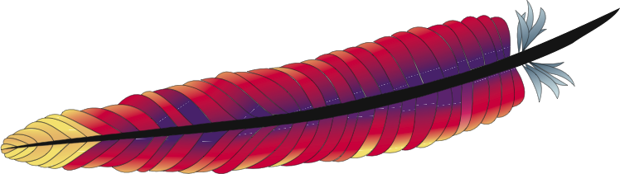



Do Not Track
Universal Web Tracking Opt Out
GET /something/here HTTP/1.1
Host: example.com
DNT: 1
Notes:
One possibility that has received a considerable amount of attention and effort in the past few years is the so-called “Do Not Track” flag.
Once you enable the “Do Not Track” feature of your browser,
Whenever your browser sends an HTTP request to a web server to download a web page,
It simply includes a new HTTP header field called DNT.
Such an option is easy to implement, and as a result most popular browsers now support it.
However, what exactly does it mean when you set this option?

Slide 21


Do Not Track
Universal Web Tracking Opt Out
Please don't track me,
pretty please???
Of course we'll
respect your privacy –
promise!
Notes:
Since it's just a standardized way to request not to be tracked, it's ultimately completely up to the web site operator whether they'll honor this option at all, or if so, how they'll interpret it.
You're basically asking, “Pretty please, don't track me”,
And there's no general way to verify whether any web site you browse to does or does not comply.
You simply have to take them at their word.

Slide 22
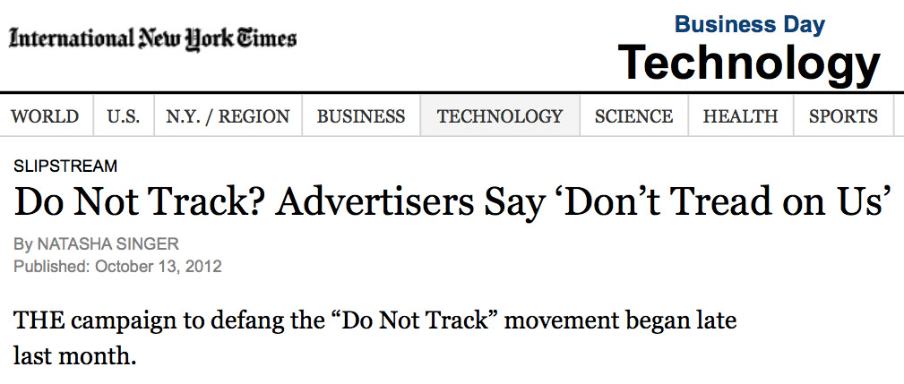
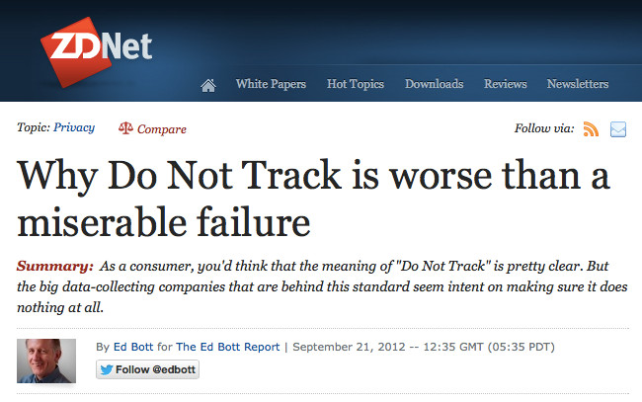

Notes:
There have been attempts to specify and standardize, and even legislate what “Do Not Track” should mean. But as you might expect, it turns out that there's a lot of resistance from major web site operators and their advertising partners even to “promise” to constrain their tracking behaviors in any way.
Last year a major advertisers consortium withdrew from the ongoing negotiations regarding what Do Not Track should mean.
As a result, Do Not Track now appears to be basically dead.

Slide 23
Commercial VPN services
Popular for circumventing the Great Firewall
  You build encrypted tunnel with VPN server
  VPN server forwards traffic to destination
  Looks like it's coming from VPN server
  Hope the server operator protects your privacy
Anonymous
Client
Anonymizing Proxy/VPN
Public
Server
Anonymous
Client

Slide 24

The current state-of-the-art
Onion routing tools such as Tor
  https://www.torproject.org
Anonymous
Client
Public
Server
Anonymous
Client
Anonymizing Relays

Slide 25
A more tracking-resistant Internet?
A few choices:
Extend NAT & proxy protocols to support pseudonyms [Han, SIGCOMM '13]
Make Tor an Internet standard [Talbot, Nov '13]
Explore new architectures for anonymity and tracking protection
Rest of this talk focuses on last approach

Slide 26
The Dissent Project
Clean-slate anonymous communications design
Offer quantifiable and measurable anonymity
Build on primitives offering provable security
Don't just patch specific vulnerabilities, but
rearchitect to address whole attack classes
http://dedis.cs.yale.edu/dissent/
[CCS'10, OSDI'12, CCS'13, USENIX Sec'13, ...]

Slide 27
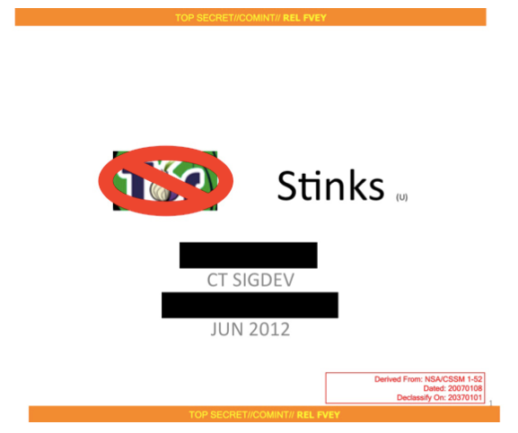
Why rethink online anonymity?
NSA says Tor is the “King of Anonymity” –
maybe onion routing is good enough?

Slide 28
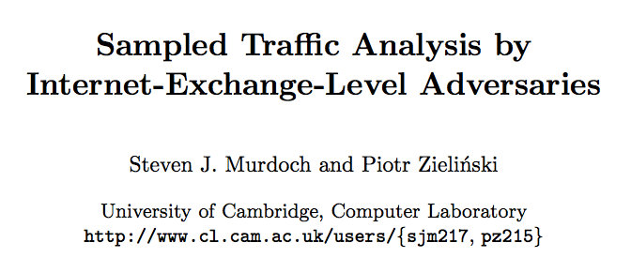
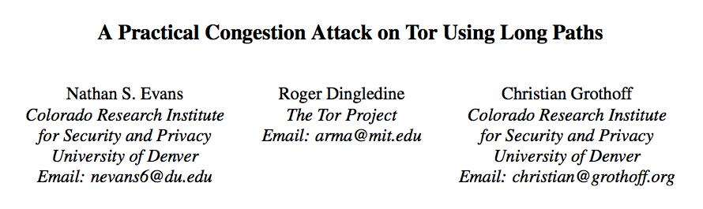
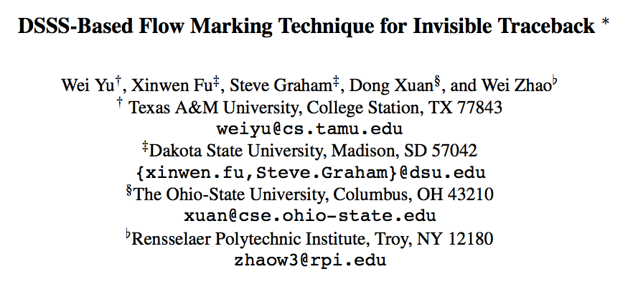
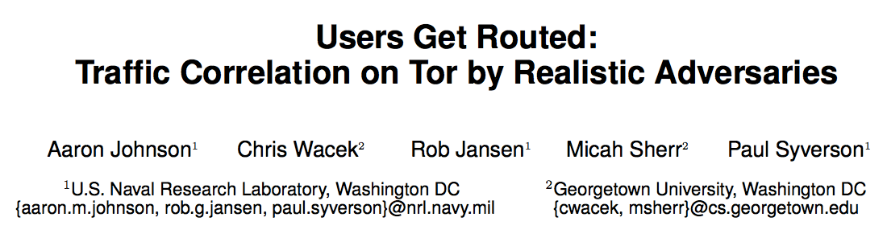
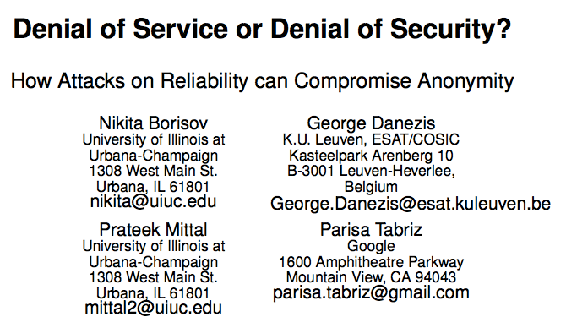
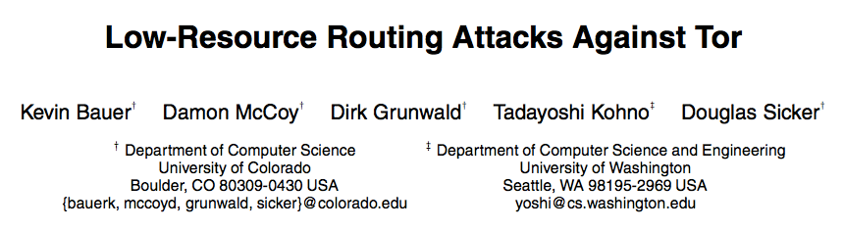
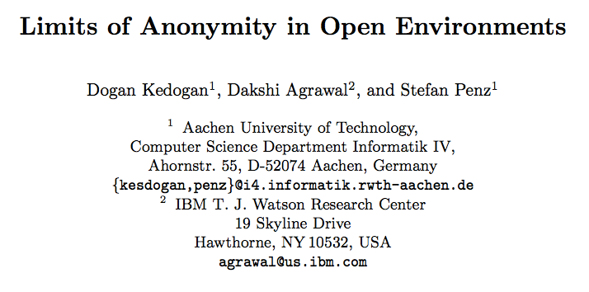
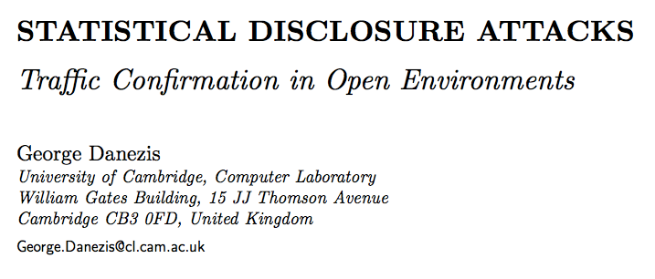
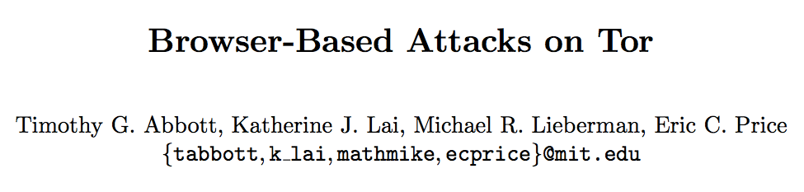
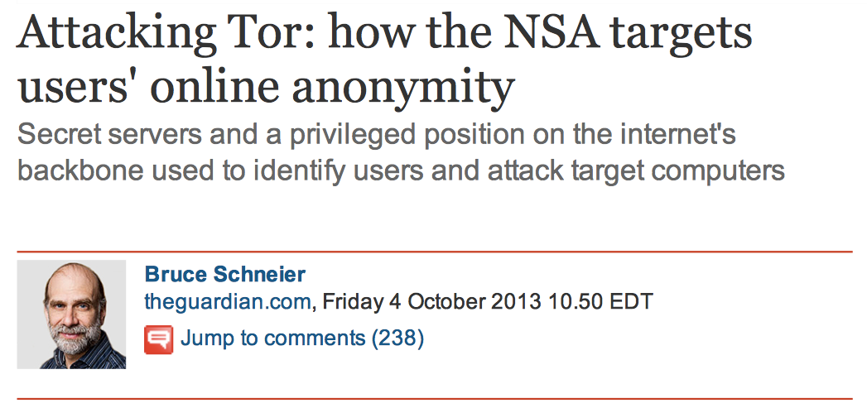
The Current State-of-the-Art
Good News: Tor probably “isn't broken yet”
Bad News: Tor, and onion routing in general,
vulnerable to five major classes of attacks
  Global traffic analysis
  Active attacks
  Denial-of-security
  Intersection attacks
  Software exploits
Question is when & how attackers will deploy

Slide 29
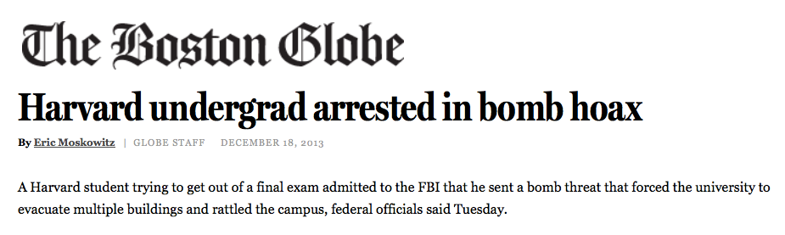
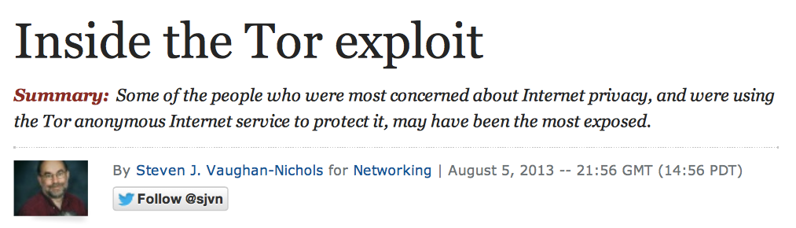
Recent De-anonymization Incidents
Tor is being broken – or circumvented – regularly

Slide 30
Recent De-anonymization Incidents
Lessons from the bomb hoax:
Traffic analysis attacks are effective
Intersection attacks are effective
Anonymity systems need accountability:
more graceful deterrents to abuse

Slide 31
Recent De-anonymization Incidents
Lessons from the Tor exploit:
Client OS isolation model is just as important
as tracking-resistance protocols themselves
Long-term anonymity requires resistance to malware, stains, beacons of all kinds

Slide 32
Talk Outline
Why Anonymity?
Current State of the Art
Grand Challenges in Anonymity
  Global traffic analysis
  Active interference attacks
  Intersection attacks
  De-anonymizing exploits
  Accountability provisions
Conclusion

Slide 33
The Traffic Analysis Problem
Most communication has a traffic pattern
  Lengths and timings of packets in each direction
  Pattern can be fingerprinted without seeing content
packet/burst lengths
Client
Server
GET index.html
Inter-
packet
times
index.html
GET logo.png
Logo.png

Slide 34
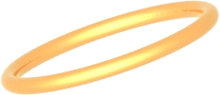


Tor Traffic Analysis Scenario
Alice in Repressistan uses Tor to post on
blog server hosted in Repressistan
State ISP controls both entry and exit hops
Fingerprint & correlate traffic to deanonymize
“The Free World”™
Aha!!
fingerprint
Tor Relays
fingerprint
Repressistan
time
RepressCo State ISP
time
Blog
Server
Alice
Alice

Slide 35
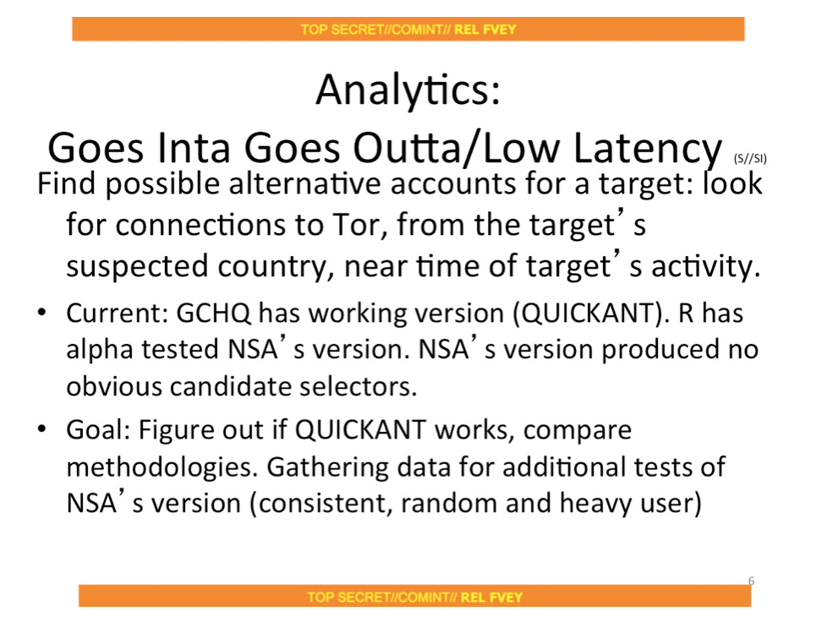
Do Attackers Actually Do This?
Not sure, but some are working hard on it...
(“Tor Stinks” slide deck, Guardian 10/4/2013)

Slide 36
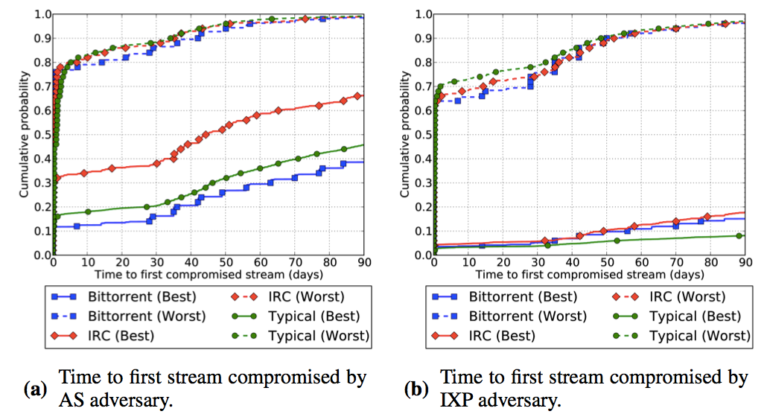
Can De-Anonymize “Real” Users?
Yes, if attacker can monitor an Internet AS or IXP
“Users Get Routed”, Johnson et al. CCS 13

Slide 37
Dining Cryptographers (DC-nets)
Another fundamental Chaum invention from the 80s...
Key property: provable anonymity within a group
Alice’s
Secret
Alice
Alice+Charlie's
Random Bit
1

0
0
Alice+Bob's
Random Bit
1

1

Charlie
=1
0

Bob+Charlie's
Random Bit
1
Bob

Slide 38
Why DC-nets Doesn't Scale
Computation cost: N×N shared coin matrix
Network churn:
if any participant disappears,
all nodes must start over
Disruption:
any single “bad apple”
can jam communication
BLAH BLAH BLAH … !!!

Slide 39
“Dissent in Numbers” [OSDI 12]
Scalable DC-nets using client/multi-server model
Clients share coins only with servers
As long as at least one honest server exists,
yields ideal anonymity among all honest clients
Anonymity Providers
M Servers
N×M coins
N Clients

Slide 40
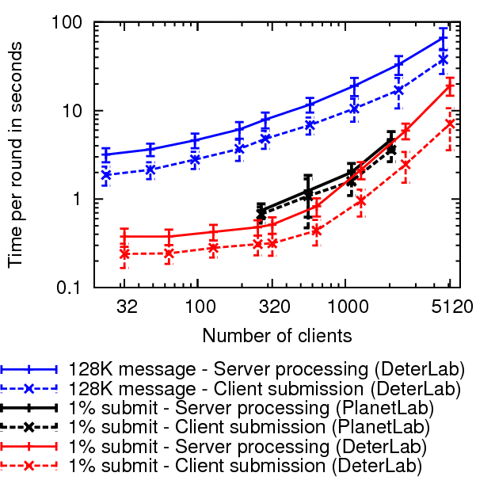
Scaling to Thousands of Clients
100 larger
anonymity sets
(Herbivore,
Dissent v1:
~40 clients)
<1 sec latency
w/ 1000 clients

Slide 41
Talk Outline
Why Anonymity?
Current State of the Art
Grand Challenges in Anonymity
  Global traffic analysis
  Active interference attacks
  Intersection attacks
  De-anonymizing exploits
  Accountability provisions
Conclusion

Slide 42
The Ups and Downs of Diversity
Tor has a highly diverse worldwide user base
Diverse types of users, countries, languages
Diverse reasons for using Tor
This diversity is crucial for the Tor system...
but no individual user gets all that “anonymity”
Most excluded due to location, time, language...
There is no meaningful anonymity
except within a meaningful community
of users who might plausibly behave like you

Slide 43
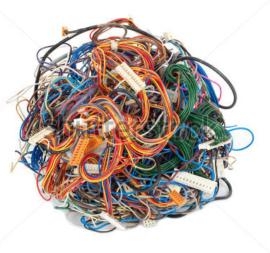
Tor hides you in a tangle of wires...

Slide 44

...or a plate of spaghetti

Slide 45

But tug on either end of a strand...

Slide 46

...and you'll find the other

Slide 47
Active Attacks
Attacker perturbs performance to inject traceable side-channel “markers” into flows
Example: “congestion attacks” against Tor
(e.g., Murdoch 05, Evans 09)
Create load to cause congestion, delay
See which emerging flows
are affected
Attack Client
Victim Client
Public
Server

Slide 48
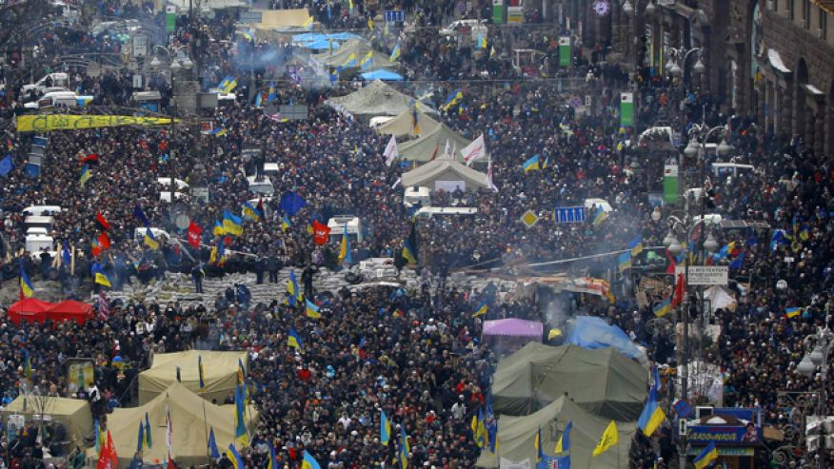
“Community-oriented Anonymity?”
Goal: build strength from groups of like-minded users engaging in collective activities...

Slide 49

Collective Control Plane (CCP) Model
Policy Oracle controls when/how much to send
But does not know who owns which nyms
(can't leak!)
Collective
Control Plane
Users
Secret
inputs
Public
outputs
Nyms
DC-nets
Data Plane

Slide 50
Implementing the CCP
Accountable replication of control plane logic
Each server implements copy, all must agree
Trustee A
Trustee B
Trustee C
Control
Plane”
Control
Plane”
Control
Plane”
Accountable
Replication
Servers
Data
Plane
Data
Plane
Data
Plane
Anytrust
DC-nets
Dissent Group
Clients

Slide 51

How CCP Counters Active Attacks
Onion routing preserves individual flow properties:
Dissent output paced by collective control:
delay pattern
pattern preserved
onion
routers
Control Plane
DC-nets
Anonymizer

Slide 52
Talk Outline
Why Anonymity?
Current State of the Art
Grand Challenges in Anonymity
  Global traffic analysis
  Active interference attacks
  Intersection attacks
  De-anonymizing exploits
  Accountability provisions
Conclusion

Slide 53
The Bomb Hoax Attack
The Harvard bomb hoaxer was de-anonymized
by a specially trivial intersection attack
Users
online
in/around
Harvard
All
Tor users
worldwide

Slide 54
The Intersection Attack Problem
Kate signs posts with pseudonym “Bob”
Posts signed messages at times T1, T2, T3
Police intersects user sets online each time
“The Free World”™
Tor
Blog
Server
Aha!!
Repressistan
RepressCo State ISP
users
online
at T1
online at T2
online at T3

Slide 55
Buddies [CCS '13]
First attempt at building intersection attack resistance into a practical anonymity system
Goals:
Measure anonymity under intersection attack
Actively mitigate anonymity loss
Enforce lower bounds by trading availability

Slide 56
Buddies Conceptual Model
Focus: what adversary learns from online status
Policy
Oracle
Users
Online/
Offline
Nyms
Secret
inputs
Public
outputs
Anonymizer
Adversary sees
who is/isn't online,
but not secret inputs
Adversary sees
public outputs

Slide 57
Computing Anonymity Metrics
Policy Oracle simulates an adversary's view
Knows who's online each round (via “tags”)
Performs “intersection attacks” against Nyms
Computes anonymity metrics
  Possinymity: “possibilistic deniability”
  Indinymity: “probabilistic indistinguishability”
Reports metrics, uses them in policy decisions

Slide 58
Possinymity: Possibilistic Deniability
Set of users who could conceivably own Nym
Intersection of sets of all users online and unfiltered in rounds where a message appears
Simplistic, but may build “reasonable doubt”
Nym's Initial Anonymity Set
← clients/users online →
“hey”
Users Online in
Subsequent
Rounds
O
“foo”
O
O
“bar”
Resulting
Possinymity Set

Slide 59
The “Statistical Disclosure” Problem
Nym's Initial
Anonymity Set
← clients/users online →
“a”
“b”
“c”
O
O
O
Possinymity Set
Indinymity Sets

Slide 60
How Dissent Preserves Indinymity
Nym's Initial
Anonymity Set
← clients/users online →
“a”
“b”
“c”
X
X
X
O
X
X
X
X
X
X
O
X
X
X
X
X
X
O
X
X
X
Possinymity Set
Indinymity Sets

Slide 61
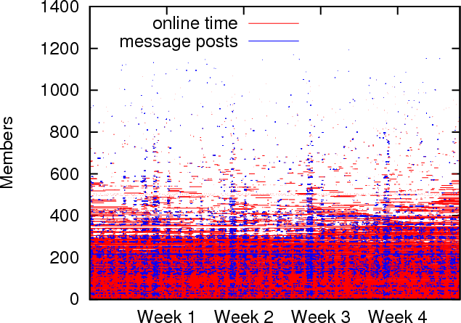
How effective? Depends on users...
Analysis based on IRC online status traces
Ephemeral users
Where intersection attack resistant anonymity sets may plausibly be found

Slide 62
Key policy and usage model issues
In what contexts might Buddies be realistic?
Quickie browsing: get online long enough to do your thing, then erase all linkable state
Blogging: delay-tolerant anonymity among users who sign on at least once a day
Always-on apps: BitTorrent-like background activities that encourage users to stay online
What if your buddy set is stacked with bad-guys?
Policy choices: e.g., “random” vs “reliable”

Slide 63
Talk Outline
Why Anonymity?
Current State of the Art
Grand Challenges in Anonymity
  Global traffic analysis
  Active interference attacks
  Intersection attacks
  De-anonymizing exploits
  Accountability provisions
Conclusion

Slide 64

Typical System Model
Unprotected
Connection
Web
Browser
“Here's My IP address!”
Application Processes
GUI
Web
Browser
Tor Client
Proxy
Alice
Tor Protected
Connection
OS Kernel
Malicious JavaScript
Browser Exploit
Client Host

Slide 65
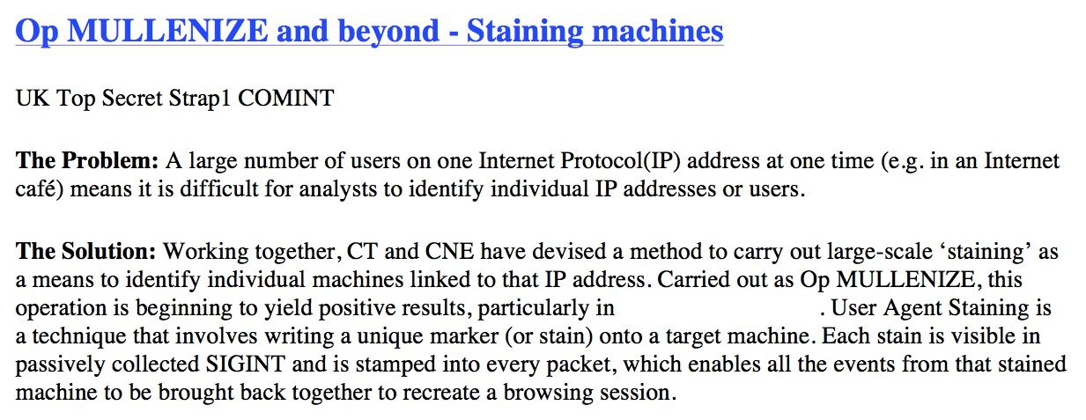
Exploits: The Low-Hanging Fruit
Circumvent the Anonymizer, Attack the Browser

Slide 66


WiNon: VM-hardened Anonymity
User Host
Browser etc runs in
“pseudonym VMs”
Can communicate only
via Dissent and/or Tor;
IP address = 192.168.1.1
Anon VM
Browser + plugins
Anonymous
TCP/UDP
Dissent
Client
Web
Services
Dissent
Group
Running on
SAFERLAB
Internet
Dissent
Server
Exit Relay

Slide 67
Talk Outline
Why Anonymity?
Current State of the Art
Grand Challenges in Anonymity
  Global traffic analysis
  Active interference attacks
  Intersection attacks
  De-anonymizing exploits
  Accountability provisions
Conclusion

Slide 68
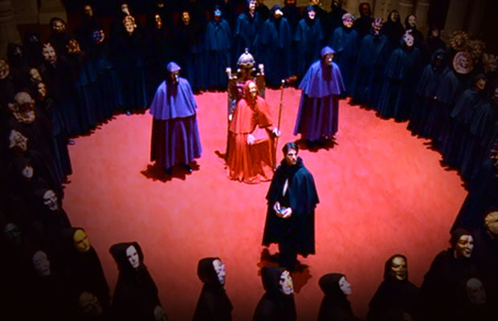
Returning to the bomb hoax
Bomb threats are an abuse of anonymity. But:
Kids do stupid things
It's our job
to educate them
Is unmasking
(& 5 years jail)
the only way
to deter abuse?

Slide 69
Accountable Anonymity
Accountability can mean many things
“Accountability & Deterrence” [Feigenbaum'11]
We need deterrents that escalate gracefully
Threat of censure by peers in online forum
Opportunity to retract without unmasking
Expulsion from group without unmasking
Unmasking only as a last resort, via transparent procedures – not secret spy tech

Slide 70
Accountability in Dissent
Dissent model can provide:
Authenticated pseduonyms
  If you post apology and reaction,
  peers (and cops) know it's same you
1-to-1 mapping of users to pseudonyms
  If you get banned, you can't just pop up again
Decentralized authority
  If all Dissent server operators agree you're a hardened criminal, they can de-anonymize you

Slide 71
Accountability Schemes in Dissent
Dissent v1 [CCS'10]:
use Brickell/Shmatikov shuffle to distribute
hash-checked assignments before round
  Simple, but requires expensive shuffle each round
Scalable Dissent [OSDI '12]:
retroactive disruption-tracing “blame” protocol
  Complex, efficient when not disrupted
Verifiable Dissent [USENIX Sec 13]:
proactive verifiability via zero-knowledge proofs
  Offline possible, lower blame cost when disrupted

Slide 72
Talk Outline
Why Anonymity?
Current State of the Art
Grand Challenges in Anonymity
  Global traffic analysis
  Active interference attacks
  Intersection attacks
  De-anonymizing exploits
  Accountability provisions
Conclusion

Slide 73
Dissent: Current Status
Proof-of-concept works, available on github
  Preliminary: not at all feature-rich, user-friendly
  Don't use it [yet] for security-critical activities!
Takes a few steps, but many questions remain
  How well can we make it perform, scale?
  Broadcast limits scalability for “point-to-point” use
  Might be very efficient for multicast applications
    Anonymous chat/microblogging, “town hall” meetings
Time (and further development) will tell!

Slide 74
Key Future Work Questions
Can we refit the Internet with tracking resistance?
Make traffic analysis resistant protocols even more scalable, get everyone running them
Community-oriented applications giving people strength in numbers via relevant anonymity sets
Create usage models enabling and incentivizing intersection attack resistant user behaviors
Build pseudonym isolation, stain resistance into popular client-side operating systems
Graceful abuse response through accountability

Slide 75
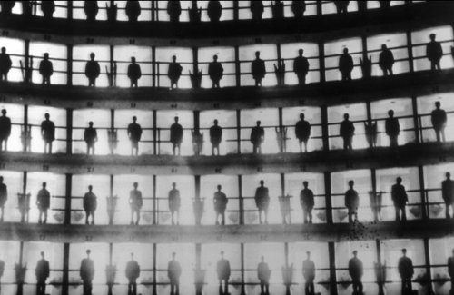
Conclusion
Can you hide in an Internet panopticon?
It's hard! – due to five grand anonymity challenges
  Global traffic analysis
  Active attacks
  Intersection attacks
  Software exploits
  Accountability
Dissent takes a few baby steps toward solutions,
but only a starting point for trustworthy anonymity
http://dedis.cs.yale.edu/dissent/

