Slide 1
Private Eyes:
Secure Remote
Biometric Authentication
Ewa Syta¹, Michael J. Fischer¹, David Wolinsky¹, Abraham Silberschatz¹, Gina Gallegos-Garcia², and Bryan Ford¹
¹Yale University and ²National Polytechnic Institute of Mexico

Slide 2
Outline
Motivation
Introducing Private Eyes
Private Eyes Protocol
Implementation / Evaluation
Conclusion

Slide 3


Motivation
Many applications demand verification of identity
  Ensure only legitimate access to protected resources
  Provide client-specific services
Challenges
  Passwords are hard to remember
  Reuse of passwords
  Fail when a database is compromised
What was my password?
Password
Mallory
Peggy
Victor
Password Database

Slide 4
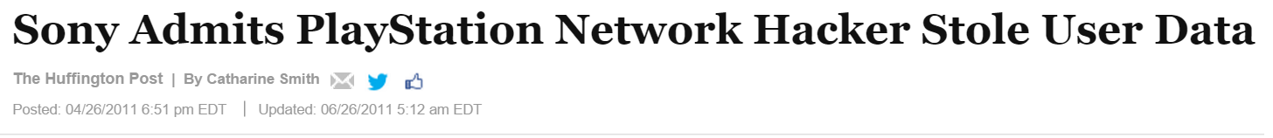
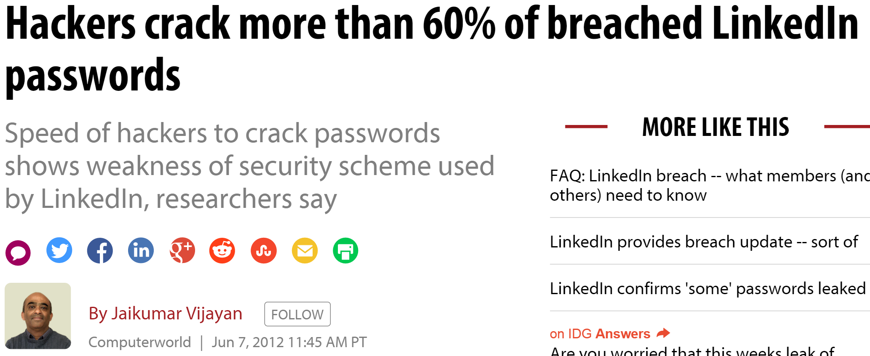
Motivation
Many applications demand verification of identity
  Ensure only legitimate access to protected resources
  Provide client-specific services
Challenges
  Passwords are hard to remember
  Reuse of passwords
  Fail when a database is compromised
Password
Mallory
Peggy
Victor
Password Database

Slide 5
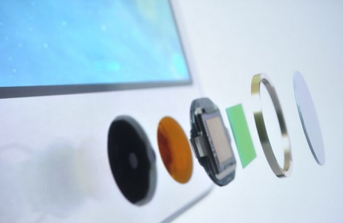
Motivation – Biometrics
Uniquely identify an individual
No need to remember, always with you
Applications for localized verification: IPhones and laptop fingerprint scanners
Challenge: If compromised, cannot be replaced

Slide 6
Outline
Motivation
Introducing Private Eyes
Private Eyes Protocol
Implementation / Evaluation
Conclusion

Slide 7
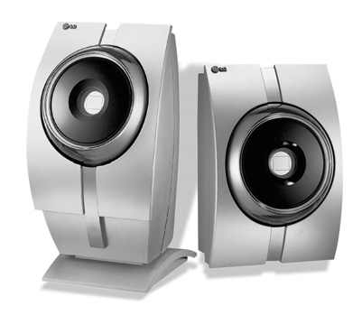
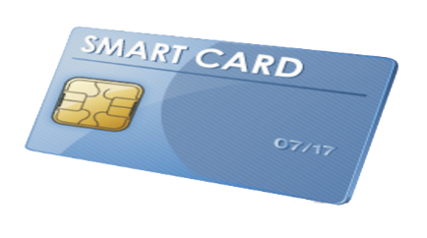
Private Eyes
Goal: Eliminate storing sensitive data on server
Insight: Use sensitive data to decrypt an authentication context
Local
Biometric
Scanner
)
Mallory
Peggy
Token
Victor
Token Database
Encrypted
Token

Slide 8
Outline
Motivation
Introducing Private Eyes
Private Eyes Protocol
Implementation / Evaluation
Conclusion

Slide 9
Security Goals
No server-side compromise of private inputs
No client-side compromise of private inputs
No cross-site impersonation
Local
Biometric
Scanner
Mallory
Peggy
Token
Victor
Token Database
Encrypted
Token

Slide 10
Protocol Phases
Enrollment
  Peggy and Victor establish token
  Peggy encrypts token using biometrics
Authentication
  Peggy decrypts token using biometric device
  Peggy sends token to Victor for verification

Slide 11

Enrollment
seed = Diffie-Hellman Exchange
Peggy
Victor
Rng := RANDOM(seed)
Value := Rng.Value()
State := Rng.State()
Template := Scanner.Scan(Peggy)
SecTemplate := Value Template
Rng := RANDOM(seed)
Value := Rng.Value()
State := Rng.State()
Peggy, Value, State
Both securely erase all contents not stored to Card and Database
SecTemplate, State
Token Database

Slide 12
Authentication
Peggy, Value, State
SecTemplate, State
Peggy, auth
auth == Peggy.Value
Token Database
Peggy
Victor
SecTemplate := Card.SecTample
Template := Scanner.Scan(Peggy)
Auth := SecTemplate Template
Rng := RANDOM(Card.State)
Value := Rng.Value()
State := Rng.State()
Template := Scanner.Scan(Peggy)
SecTemplate := Value Template
Rng := RANDOM(Peggy.State)
Peggy.Value := Rng.Value()
Peggy.State := Rng.State()
Both securely erase all contents not stored on Card and Database

Slide 13
Security Analysis
If Victor is compromised
  Mallory can impersonate Peggy only to Victor, no where else
If Peggy is compromised
  Backtracking resistant RNG prevents Mallory from stealing of Peggy’s template
If both Peggy and Victor are compromised
  Breaks security assumption
  Mallory can learn the current secured template

Slide 14
Suitable Authentication Mechanisms
Passwords: Password SecTemplate == State
Eyes (Iris): Iris Template SecTemplate ~= State
  Uses hashing distance to compute similarity
  Hashing distance / max distance == .32, false match in roughly 1 in 26 million

Slide 15
Synchronization
Peggy transmits current authentication attempt
If she is ahead, Victor scans ahead (within reason)
If she is behind, Victor tells her to go forward
If she is too far ahead, re-enrollment may be required
Peggy, auth, attempt #
False, expected attempt #
Peggy
Victor

Slide 16
Outline
Motivation
Introducing Private Eyes
Private Eyes Protocol
Implementation / Evaluation
Conclusion

Slide 17
Implementation
C++ client / server modules
Template extractors:
  Project Iris written in C++/Qt
  Masek’s Iris Recognition ported to Octave
Crypto Library Crypto++
  RNG – Blum Blum Shub
SQLite database for server backend
SERVER
PE SERVER MODULE
USER DB
CLIENT
PE CLIENT MODULE
TOKEN
PRIVATE INPUT

Slide 18
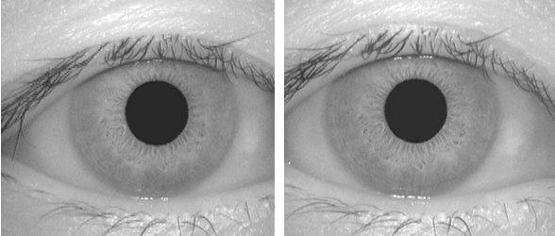
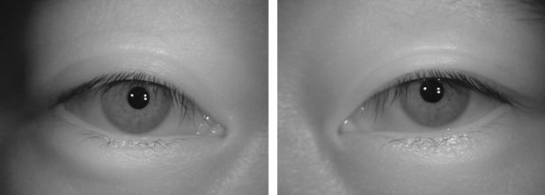
CASIA Databases
Version 1
  Preprocessed images
  108 subjects, total of 758 images
Version 2
  60 subjects, total of 2400 images

Slide 19
Time for Enrollment
Template size:
C++: ~9KB
Octave: ~40KB

Slide 20
Time for Authentication
Min. Difference Score 0.32
False match 1 in 26 million

Slide 21
Outline
Motivation
Introducing Private Eyes
Private Eyes Protocol
Implementation / Evaluation
Conclusion

Slide 22
Conclusion
Private Eyes offers:
Two factor authentication that offers privacy preservation on sensitive information
Offers reasonable performance for authentication time
A step toward making online biometric authentication possible

Slide 23
Feature Extraction Reliability

Slide 24
Time for Feature Extraction

