Slide 1
I Want My Voice to Be Heard:
IP over Voice-over-IP for Unobservable Censorship Circumvention
Amir Houmansadr (The University of Texas at Austin)
Thomas Riedl (University of Illinois at Urbana-Champaign)
Nikita Borisov (University of Illinois at Urbana-Champaign)
Andrew Singer (University of Illinois at Urbana-Champaign)

Slide 2






Internet Censorship
The Internet is a big threat to repressive regimes!
Repressive regimes censor the Internet:
  IP filtering, DNS hijacking, Deep packet-inspection, etc.
Circumvention systems

Slide 3
New stage in the arms race
The threat model has changed
Past: detect circumvention end-points
Now: detect circumvention traffic also
We need traffic unobservability
against passive, active, or proactive analysis

Slide 4
A recent approach
A promising approach: hide circumvention traffic within popular Internet protocols
  Censors are unlikely to completely block that protocol
A new trend: mimic the target protocol
  SkypeMorph, StegoTorus, and CensorSpoofer (CCS’12)
It’s hard to imitate network protocols
The Parrot is Dead: Observing Unobservable Network Communications [Oakland’13]
FLAWED

Slide 5
Our approach
We seek the same objective, but take a different approach:
  Run the target protocol
By running the target protocol no need to worry about implementation quirks, bugs, protocol details
Challenge: how to efficiently encapsulate traffic into the target protocol

Slide 6
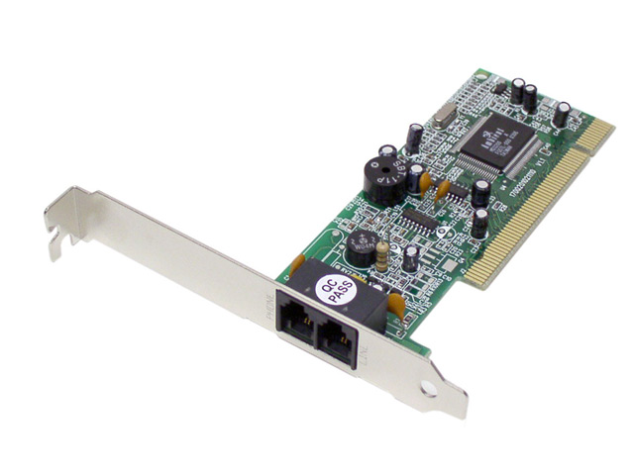
FreeWave: IP over Voice-over-IP
Target protocol: Voice-over IP (VoIP)
Why VoIP
  Widely used protocol (only 663 Million Skype users)
    Collateral damage to block
  Encrypted
How to hide?
  The dial-up modems are back!

Slide 7




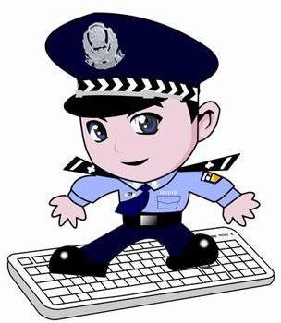

FreeWave architecture
FreeWave
Server
Client

Slide 8
System components

Slide 9
MoDem component
A typical acoustic modem
  QAM modulation
Reliable transmission
  Turbo codes
  Use Preambles

Slide 10
Evaluations

Slide 11
FreeWave’s unobservability
Comprehensive unobservability at the protocol level
Traffic analysis (packet rates and sizes)
Fixed rate codecs (e.g., G.7 series)
  Not an issue ☺
Variable bit-rates (e.g., Skype’s SILK)
  Simple analysis
  Superimpose with recoded conversation

Slide 12



Server obfuscation
FreeWave
Server
Client

Slide 13
Future directions
…
IP over
Voice over
IP over Voice-over-IP
Embed into Video of VoIP
Find other protocol to tunnel
  Look for better efficiency

Slide 14
Questions!

